Slide 1
DEAC Meeting Agenda February 6, 2014
AchieveNJ
Official Waiver Process…
Assessing and Adjusting SGOs (see attachment)
Marzano
Second Round Check-In
Third Round – Unannounced & Short (at least 20 minutes)
Domains #1-4
SGP Scoring is released
http://www.nj.gov/education/AchieveNJ/teacher/percentile.shtml
Professional Learning/Development
http://www.nj.gov/education/profdev/regs/
District & School PD Planning Requirements (see attachments)
Role of ScIP for each school
February 14, February 18, March 14 PD Days

Slide 2
Official Waiver Process
C. Official Waiver Process (from AchieveNJ and Professional Development Update 11-19-13,page 4)
As you know evaluation regulations were adopted on September 11, 2013 and became effective on October 5th. Therefore, districts seeking a waiver for some component(s) of the regulations can now apply through the official State Board process. To do this, the district should complete the form found at http://www.state.nj.us/education/sboe/ew/ and submit it to the county office.
Please note: Districts that applied for and received flexibility for some component(s) of the regulations from the Office of Evaluation this summer do not need to follow the process explained above. Instead, these districts will be contacted by the Office of Evaluation with more instructions about an expedited process. Any district with an approved flexibility request that is not contacted by November 22, 2013 should email educatorevaluation@doe.state.nj.us.

Slide 3
Assessing & Adjusting SGOs

Slide 4
SGO Steps 1 – 5

Slide 5
Marzano
Second Round Check-In
Third Round
Unannounced and Short (at least 20 minutes)
Post-conference
Elements in Domains #1-4

Slide 6
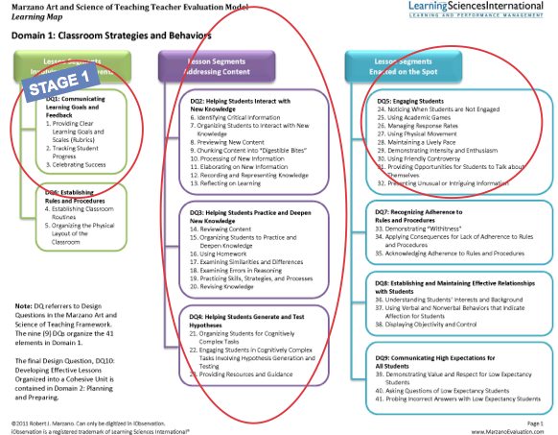
Marzano (Domain 1)

Slide 7
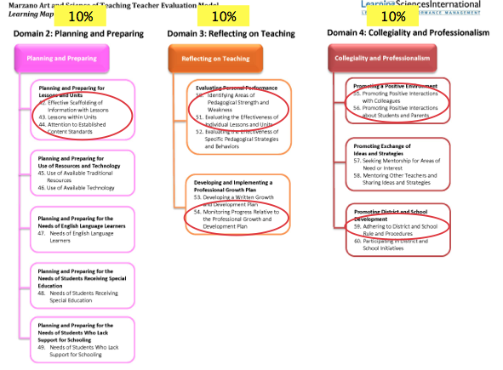
Marzano (Domains 2,3,4)

Slide 8
Student Growth Percentiles for each qualifying teacher is released
On February 4, 2014, the Department published a broadcast memo describing secure district access to 2012-13 median Student Growth Percentile (mSGP) data for all qualifying teachers.
This data does not have any consequences for this year's evaluation as it describes student growth from last school year.
Instead, the information is being provided primarily to help districts and the Department to examine the data quality, consider related professional development opportunities, and prepare for the distribution of the first official mSGP scores (for 2013-14) next year when they will count for 30% of qualifying teachers' evaluations.

Slide 9
Student Growth Percentiles for each qualifying teacher is released
District leaders were provided access to a summary of all teacher mSGP scores, as well as individual reports for each teacher indicating his/her 2012-13 mSGP.
School principals and supervisors will share these confidential reports with each teacher with the goal of connecting the mSGP to elements of the teacher's practice and to professional learning opportunities.
Please view the detailed User Guide for the Teacher mSGP Report (see attached) for background on the use of growth measures, a detailed explanation of the calculation of mSGP scores and how they convert to evaluation scores, and suggestions for sharing the data and using it to inform professional growth.

Slide 10
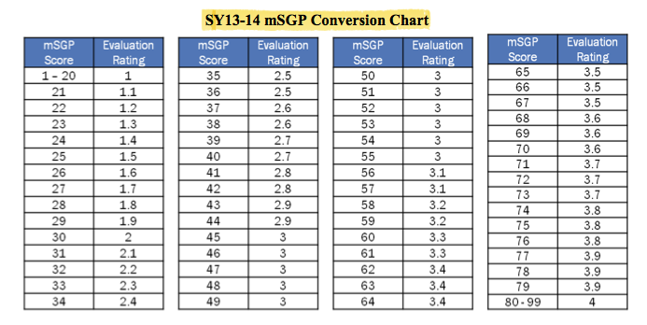
Student Growth Percentile scoring for qualifying teachers

Slide 11
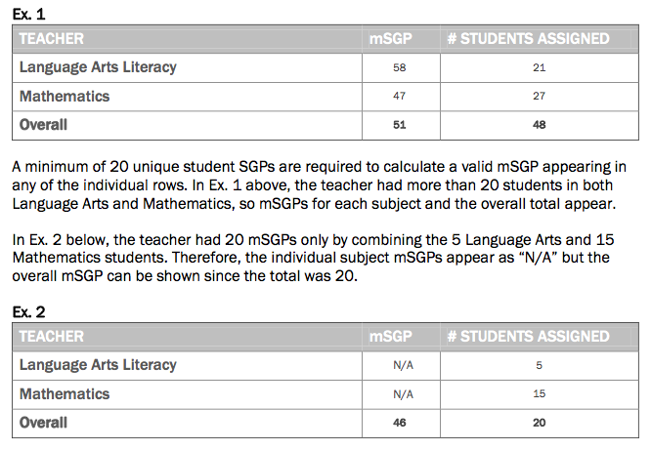
Student Growth Percentile Examples

Slide 12
Storage of SGPs
Handling and Storing mSGP Data
The Department strongly recommends that districts store mSGP data in each teacher's personnel file or in another secure manner that is easily accessible to the teacher (either electronically or on paper).
The data should be handled in the secure manner you would treat, handle, and store any part of a confidential personnel record.
Evaluation data of a particular employee shall be confidential in accordance with the TEACHNJ Act and N.J.S.A. 18A:6-120. and shall not be accessible to the public.

Slide 13
Roles of ScIP for each school
Each school is required to convene a School Improvement Panel (ScIP) that includes the principal, an assistant/vice principal, and at least one teacher.
This group must ensure, oversee, and support evaluation, professional development, and mentoring policies within the school (see the AchieveNJ ScIP Overview).
Educators should familiarize themselves with their ScIP and contact ScIP members with questions and feedback about school-level evaluation and support policies.

Slide 14
Professional Development
February 14
Student Growth Objectives
Develop Post-Assessments
Mid-Year Check-In
Adjust Scales (if necessary)
Note: If a scale needs to adjusted:
Please check with supervisor (if you have one)
It needs to be approved by the building principal
Nurses
Work on websites
CST, Special Education Teachers
IEP Revisions, PARCC Accommodations, etc.

Slide 15
Professional Development
February 18
“Do Our Assessments Measure Up?”
Teachers will try the online version of PARCC
www.parcconline.org/computer-based-samples
Go directly to the test items in grades 3-5, grades 6-8 and high school
It has sample ELA and Math questions
Take Online Professional Development
http://www.veronaschools.org/Page/3614
Reading Workshop
Work on UbD Units
Review & Revise Performance Based Tasks/Assessments (Stage 2)
Revise Activities/Lessons (Stage 3)

Slide 16
Professional Development
March 14
Grade Student Growth Objective Post-Assessments (if given)
Review & Reflect on student growth (pre to post)
Enter Data and determine score according to defined scale
Reading Workshop
Work on UbD Units
Any cross-curricular connections?
Review & Revise Performance Based Tasks/Assessments (Stage 2)
Revise Activities/Lessons (Stage 3)

